Slide 1


Expedia Hotel Recommendation

Slide 2

목차
데이터 소개
데이터 탐색
모델링
평가

Slide 3



Introduction

Slide 4

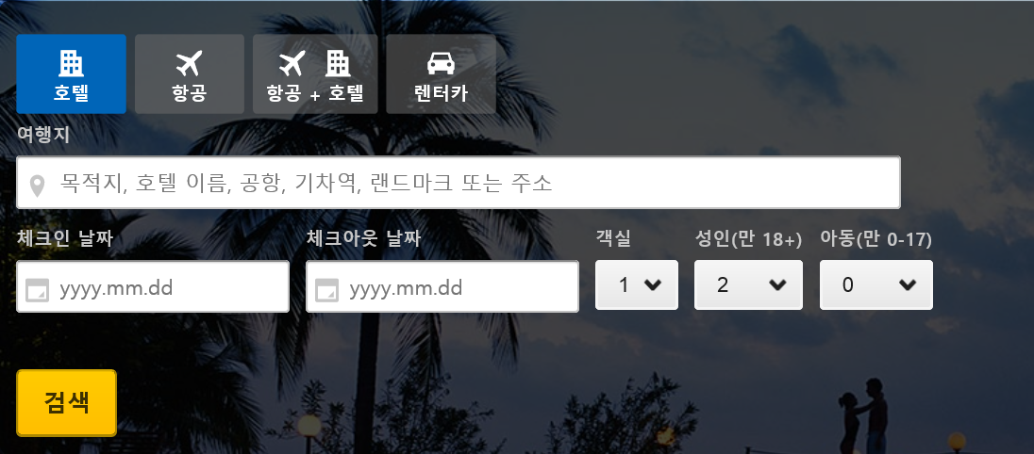
Introduction
Expedia?

Slide 5

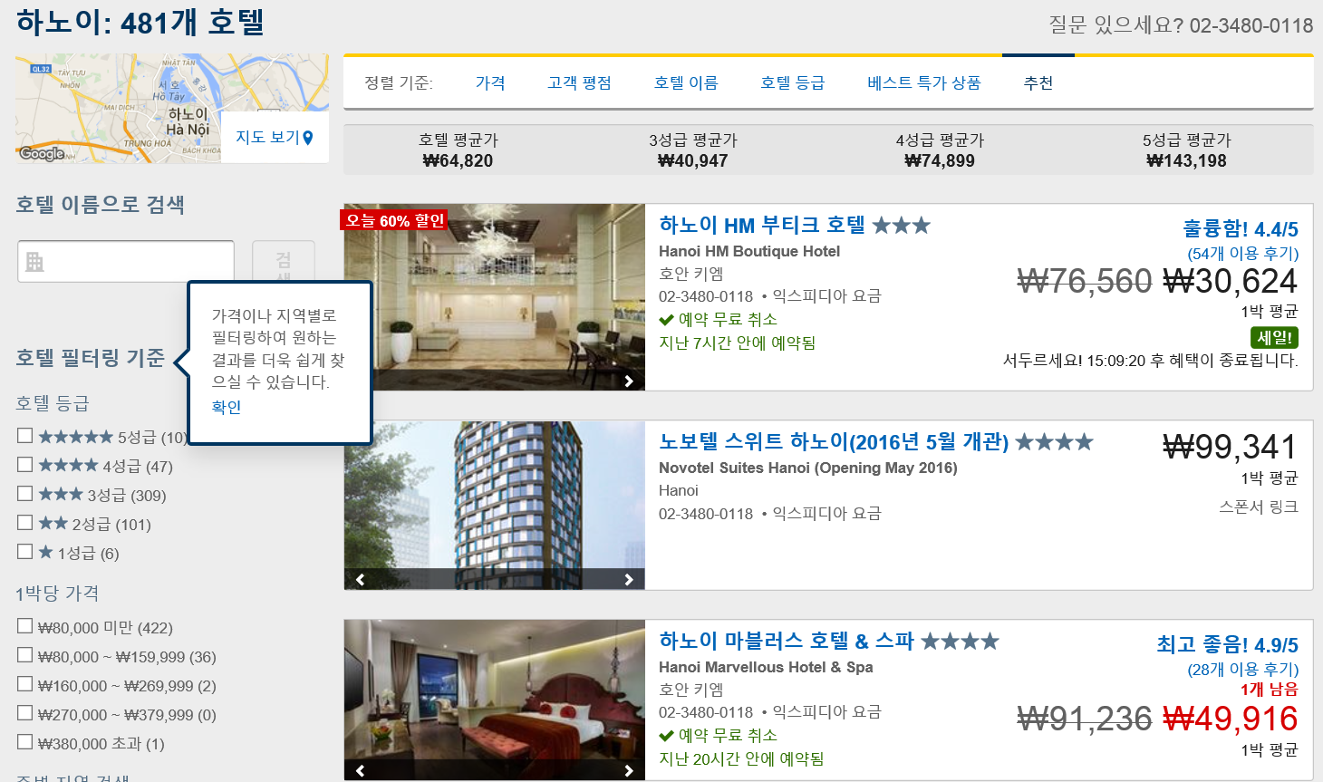
Introduction
Search Result

Slide 6

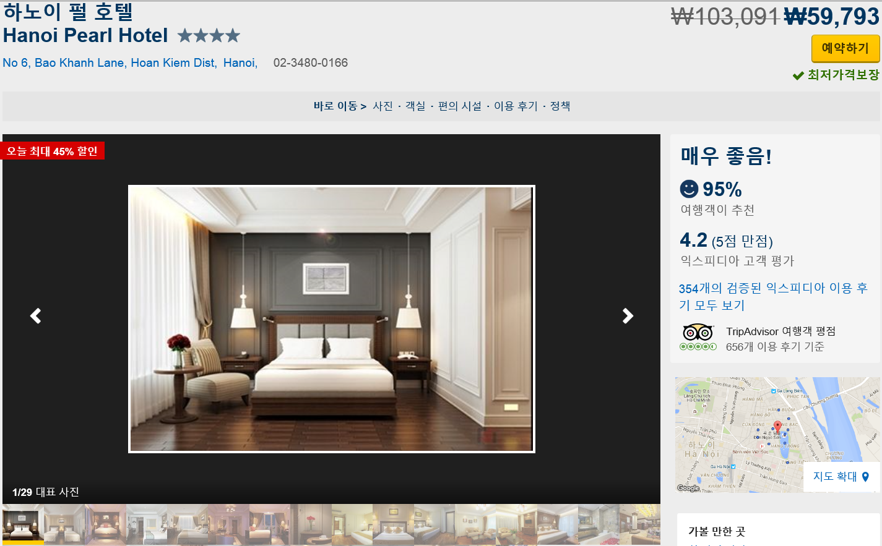
Introduction
Information

Slide 7

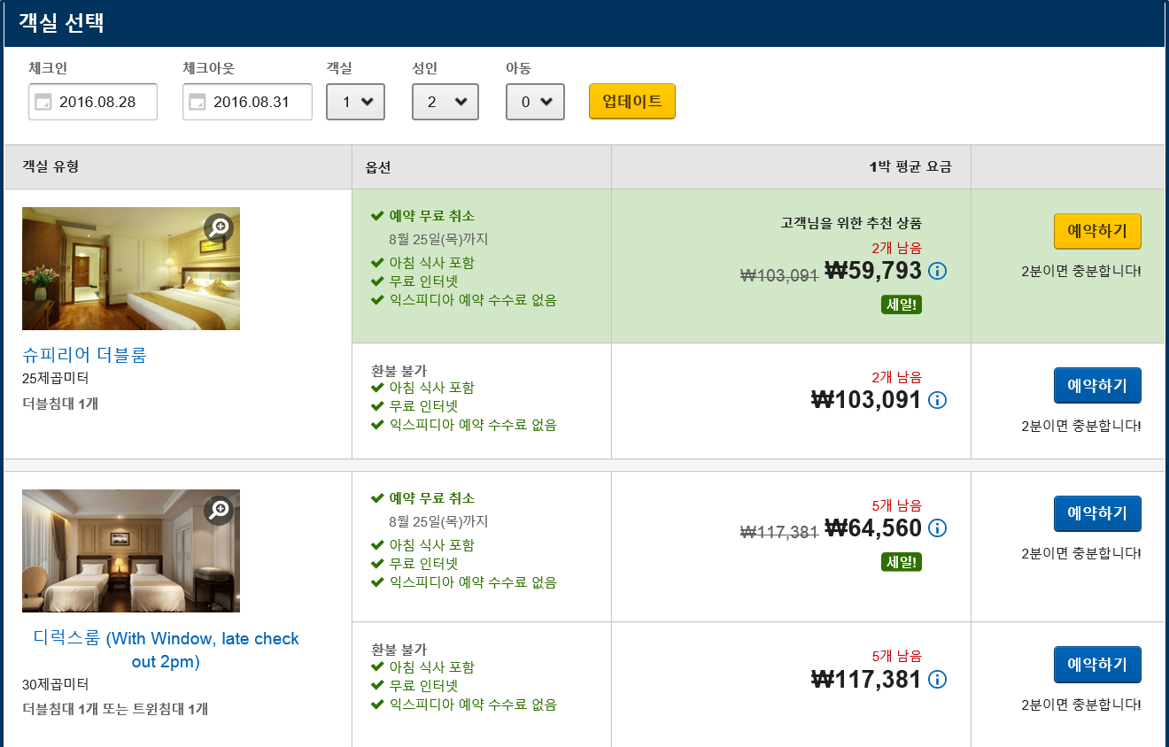
Introduction
Information

Slide 8
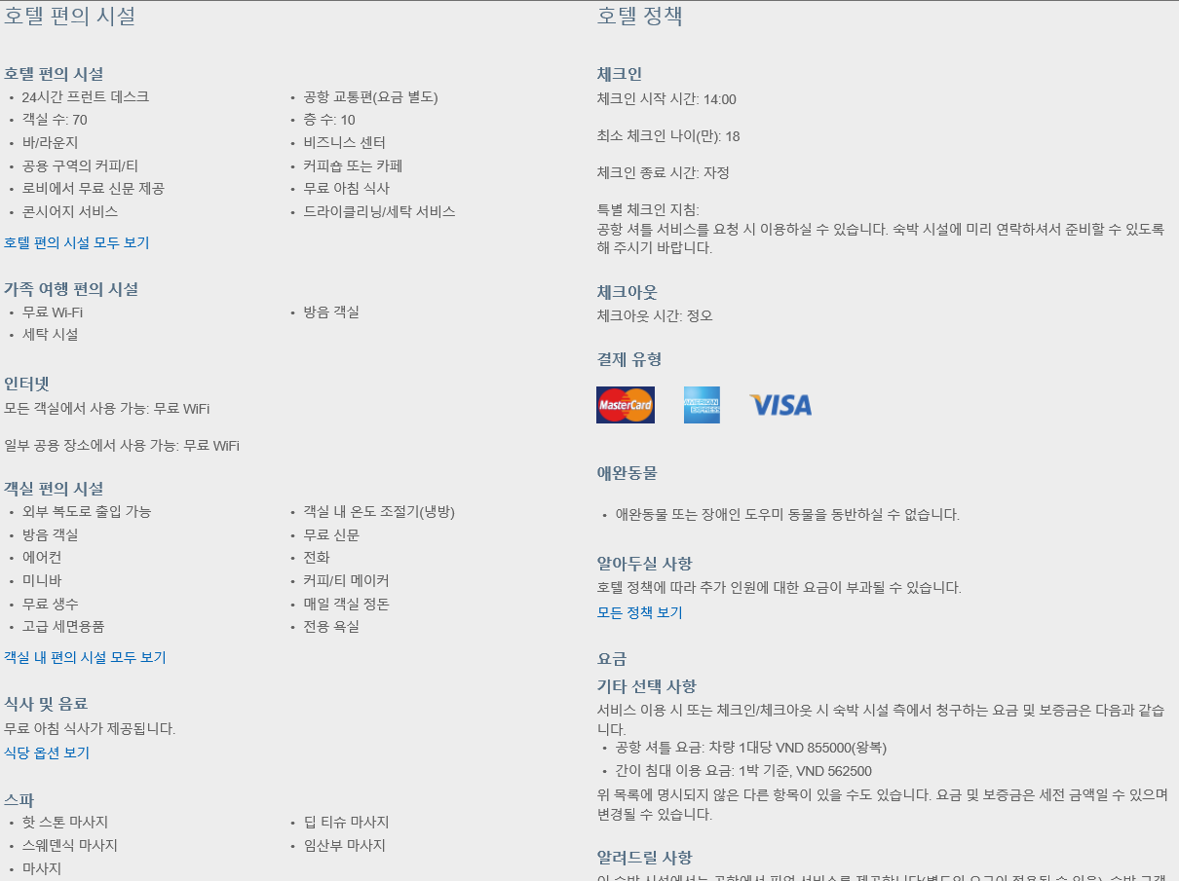
Introduction
Information

Slide 9
Data Set
train/test.csv
Column name | Description | Data type
date_time | Timestamp | string
site_name | ID of the Expedia point of sale (i.e. Expedia.com, Expedia.co.uk, Expedia.co.jp, ...) | int
posa_continent | ID of continent associated with site_name | int
user_location_country | The ID of the country the customer is located | int
user_location_region | The ID of the region the customer is located | int
user_location_city | The ID of the city the customer is located | int
orig_destination_distance | Physical distance between a hotel and a customer at the time of search. A null means the distance could not be calculated | double
user_id | ID of user | int
is_mobile | 1 when a user connected from a mobile device, 0 otherwise | tinyint
is_package | 1 if the click/booking was generated as a part of a package (i.e. combined with a flight), 0 otherwise | int
channel | ID of a marketing channel | int

Slide 10
Data Set
train/test.csv
Column name | Description | Data type
srch_ci | Checkin date | string
srch_co | Checkout date | string
srch_adults_cnt | The number of adults specified in the hotel room | int
srch_children_cnt | The number of (extra occupancy) children specified in the hotel room | int
srch_rm_cnt | The number of hotel rooms specified in the search | int
srch_destination_id | ID of the destination where the hotel search was performed | int
srch_destination_type_id | Type of destination | int
hotel_continent | Hotel continent | int
hotel_country | Hotel country | int
hotel_market | Hotel market | int
is_booking | 1 if a booking, 0 if a click | tinyint
cnt | Numer of similar events in the context of the same user session | bigint
hotel_cluster | ID of a hotel cluster | int

Slide 11
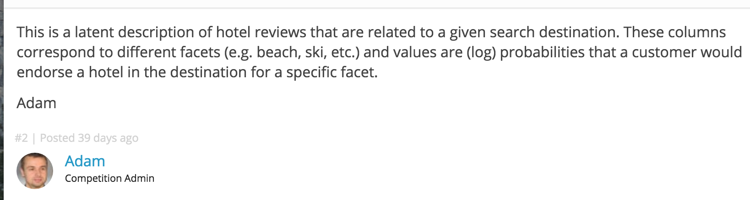
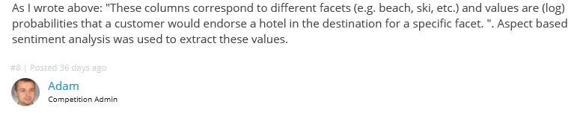
Data Set
destinations.csv
Column name | Description | Data type
srch_destination_id | ID of the destination where the hotel search was performed | int
d1-d149 | latent description of search regions | double
destinations.csv data consists of features extracted from hotel reviews text

Slide 12
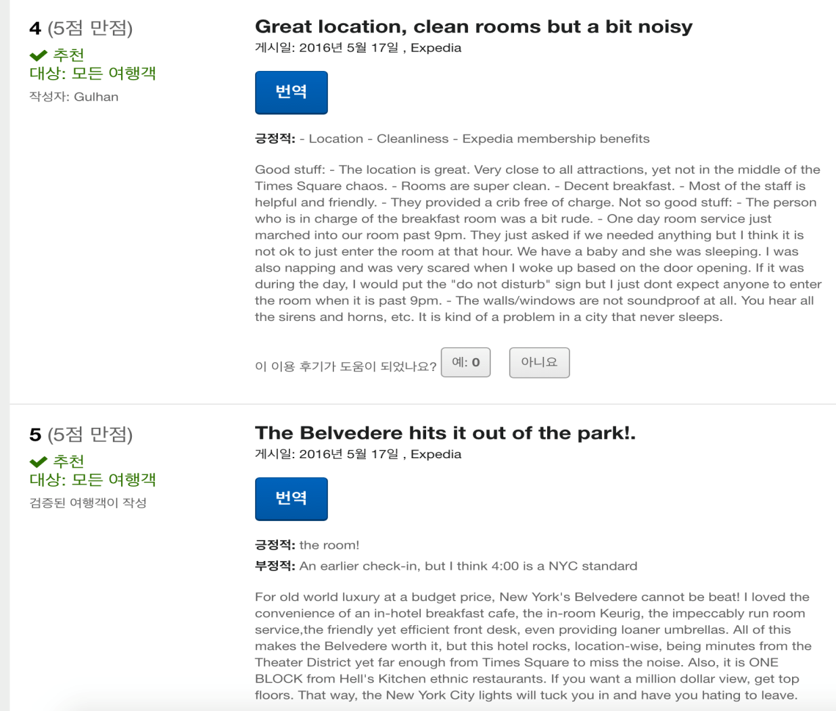
Data Set
destinations.csv

Slide 13
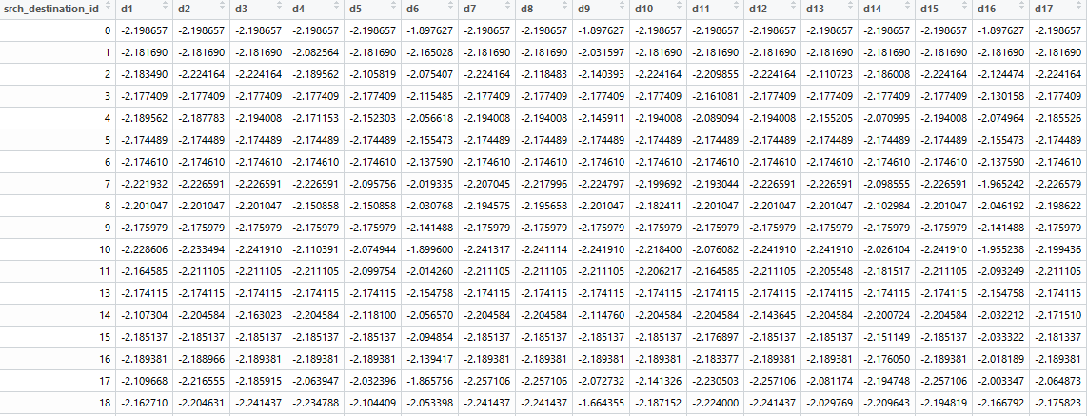
Data Description
Destination Data

Slide 14
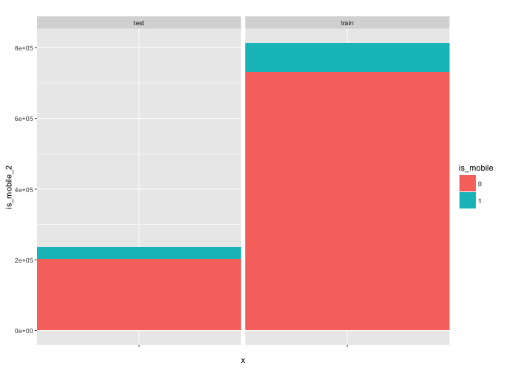
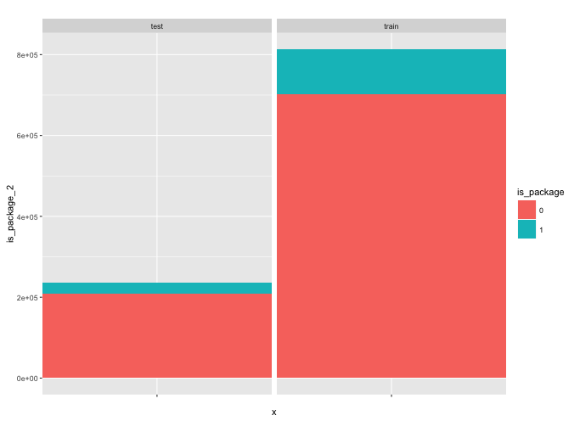
Data Description
Mobile 기기로 접속 여부 (1= mobile / 0= 그 외)
패키지 예약 여부 (1= 패키지 / 0= 그 외)

Slide 15
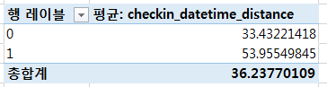
Data Description
Y: 체크인-예약 기간 X: Package 여부

Slide 16
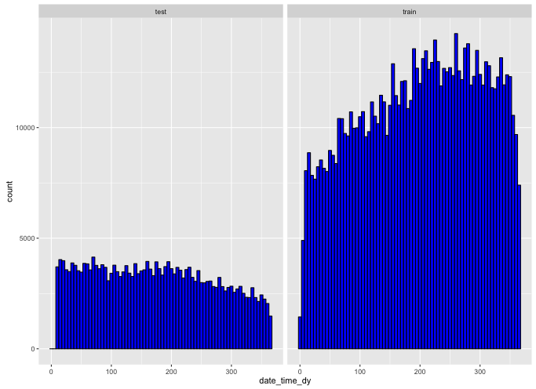
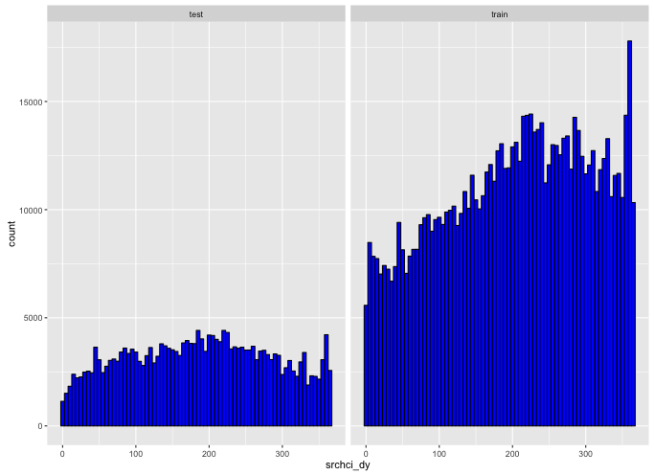
Data Description
Date_time_dy
Scrchi_dy

Slide 17
Data Description
Y: 체크인-예약 기간 X: 연초,연말 체크인 날짜
* 연초 기준 1월1일~1월10일 연말 기준 12월20~12월31일

Slide 18
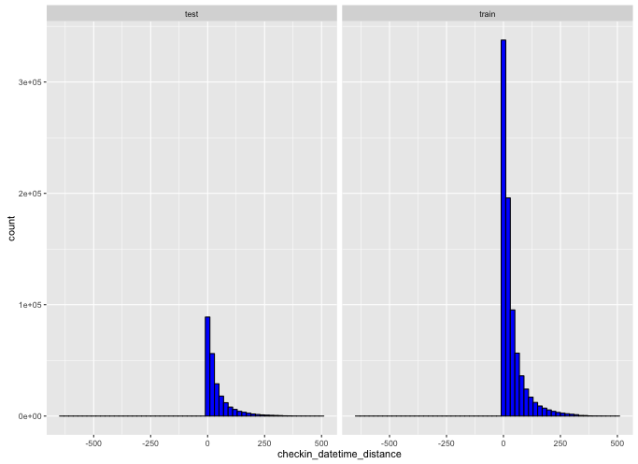
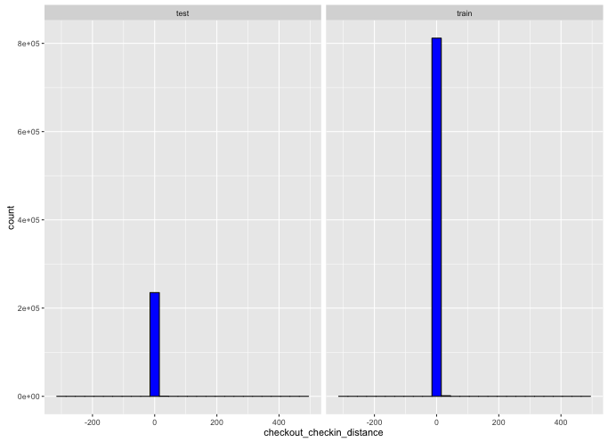
Data Description
Checkin_datetime_distance
Checkout_checkin_distance
Checkout_checkin_distance

Slide 19
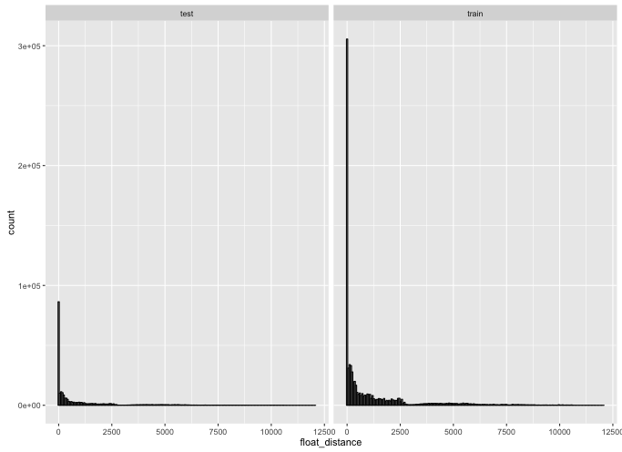
Data Description
Float_distance
Train data

Slide 20
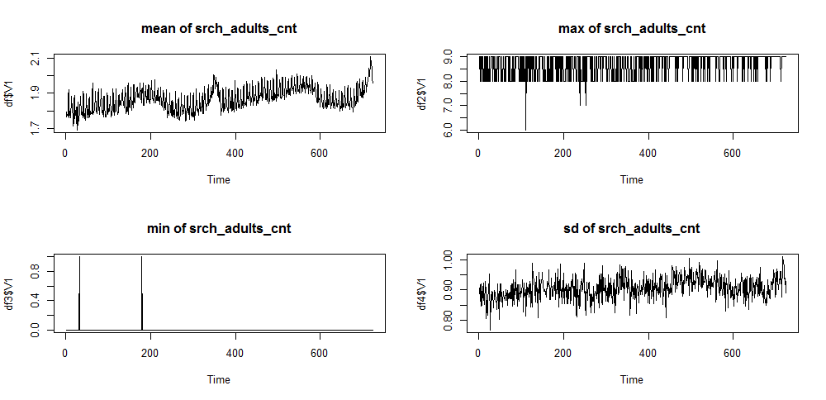
Data Description
성인수 평균에 있어서는 여름보다는 겨울에 수가 증가하는 경향이 있고 평균이 1.7~2.1사이의 분포를 갖는다.

Slide 21
Data Description
3단계. 탐색 그래프
Y: 체크인-예약 기간 X: 예약 성인의 수

Slide 22
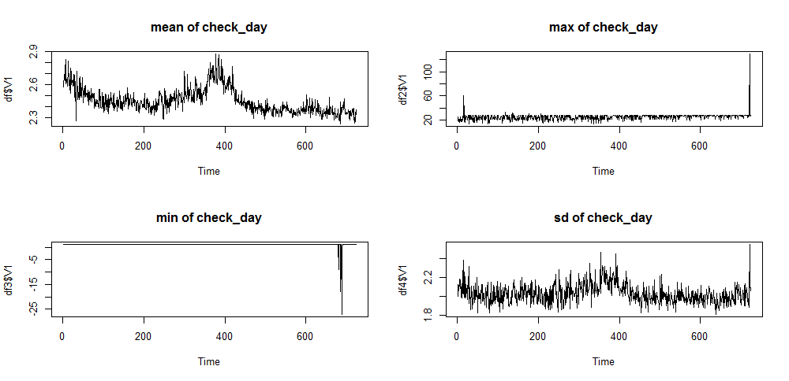
Data Description
2013년 1월, 2014년 1월 겨울시즌에 check_day 평균이 다른때보다 높은것으로 나타났다.

Slide 23
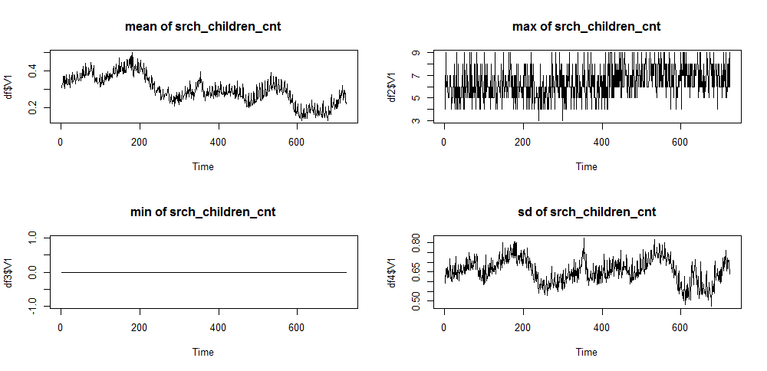
Data Description
Train data
아이들의 수는 계절에 따라 크게 차이를 보이는 것 같지는 않고 시간이 흐름에 따라 점점 감소하는 추세를 보이는 것 같다.

Slide 24
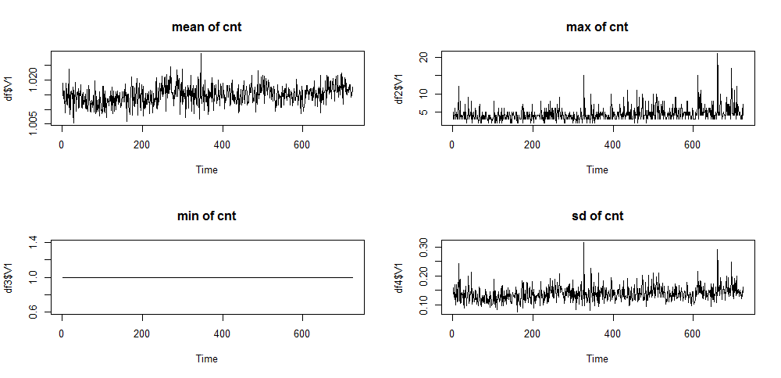
Data Description
Destination Data
최대치를 보니 가을시즌에 같은 곳을 검색을 하는 인원이 많은 것으로 보인다.

Slide 25
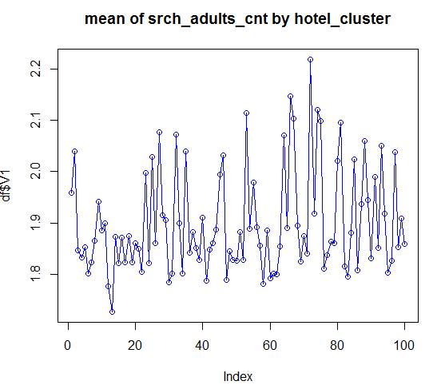
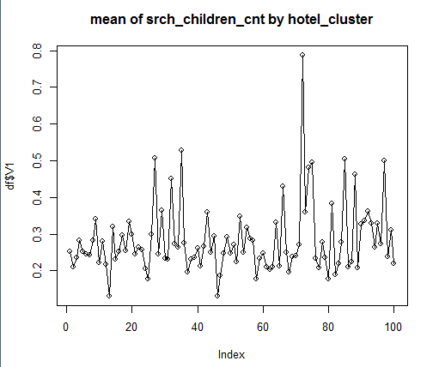
Data Description
Hotel_cluster에 따른 성인 평균수
Hotel_cluster에 따른 아이 평균수

Slide 26
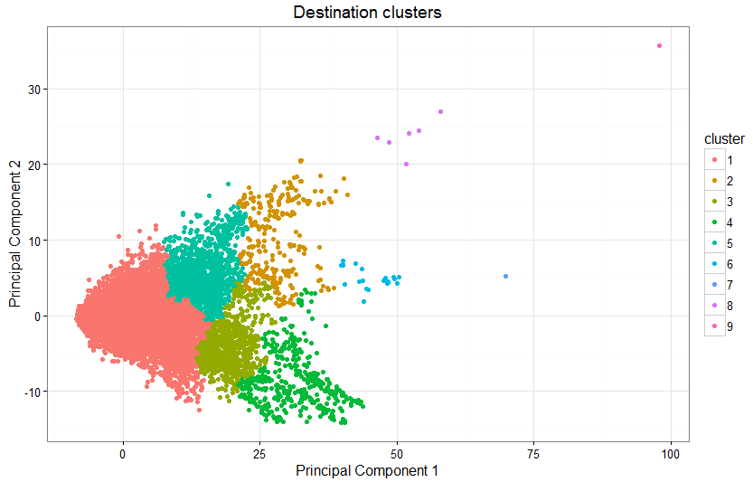
Model
Rcode
1단계. Destination 파일 PCA (지역에 대한 감성분석 리뷰, 컬럼이 무슨 의미를 갖는지는 모름)
de <- read.csv("destinations.csv", header=T)
ir.pca <- prcomp(de, center = TRUE, scale. = TRUE)
de2 <- predict(ir.pca, newdate=de)
summary(ir.pca)
write.csv(de2, "E:/kaggle/expedia/destinations2.csv", row.names=F)
Pca 12개 축이면 해당데이터 70% 설명함
> summary(ir.pca)
Importance of components:
PC1 PC2 PC3 PC4 PC5 PC6
Standard deviation 8.7581 2.87986 2.05774 1.8657 1.55363 1.44581
Proportion of Variance 0.5114 0.05529 0.02823 0.0232 0.01609 0.01394
Cumulative Proportion 0.5114 0.56665 0.59488 0.6181 0.63417 0.64811
PC7 PC8 PC9 PC10 PC11 PC12
Standard deviation 1.29545 1.24069 1.18812 1.1024 1.07980 1.07134
Proportion of Variance 0.01119 0.01026 0.00941 0.0081 0.00777 0.00765
Cumulative Proportion 0.65930 0.66956 0.67897 0.6871 0.69485 0.70250
PC13 PC14 PC15 PC16 PC17 PC18
Standard deviation 1.05595 1.04190 1.02907 0.99095 0.97432 0.96494
Proportion of Variance 0.00743 0.00724 0.00706 0.00655 0.00633 0.00621
Cumulative Proportion 0.70993 0.71717 0.72423 0.73077 0.73710 0.74331
PC19 PC20 PC21 PC22 PC23 PC24
Standard deviation 0.95531 0.93219 0.9162 0.91101 0.89297 0.8912
Proportion of Variance 0.00608 0.00579 0.0056 0.00553 0.00532 0.0053
Cumulative Proportion 0.74939 0.75519 0.7608 0.76632 0.77163 0.7769
PC25 PC26 PC27 PC28 PC29 PC30
Standard deviation 0.87678 0.86056 0.84467 0.84321 0.82707 0.82037
Proportion of Variance 0.00512 0.00494 0.00476 0.00474 0.00456 0.00449
Cumulative Proportion 0.78205 0.78699 0.79175 0.79649 0.80105 0.80553
PC31 PC32 PC33 PC34 PC35 PC36
Standard deviation 0.81356 0.79642 0.7844 0.77752 0.77367 0.75960
Proportion of Variance 0.00441 0.00423 0.0041 0.00403 0.00399 0.00385
Cumulative Proportion 0.80995 0.81417 0.8183 0.82231 0.82630 0.83014
PC37 PC38 PC39 PC40 PC41 PC42
Standard deviation 0.75401 0.74885 0.74074 0.7353 0.72277 0.71048
Proportion of Variance 0.00379 0.00374 0.00366 0.0036 0.00348 0.00337
Cumulative Proportion 0.83393 0.83767 0.84133 0.8449 0.84842 0.85178
PC43 PC44 PC45 PC46 PC47 PC48
Standard deviation 0.70175 0.69519 0.68776 0.68503 0.67574 0.67227
Proportion of Variance 0.00328 0.00322 0.00315 0.00313 0.00304 0.00301
Cumulative Proportion 0.85507 0.85829 0.86144 0.86457 0.86761 0.87063

Slide 27
Model
MS-SQL
2단계. 데이터 전처리(MSSQL)
select *
into #temp
from(
select 0 as id, [date_time] ,[site_name] ,[posa_continent] ,[user_location_country]
,[user_location_region] ,[user_location_city] ,[orig_destination_distance]
,[user_id] ,[is_mobile] ,[is_package] ,[channel] ,[srch_ci] ,[srch_co] ,[srch_adults_cnt]
,[srch_children_cnt] ,[srch_rm_cnt] ,[srch_destination_id] ,[srch_destination_type_id],[hotel_continent]
,[hotel_country],[hotel_market], [is_booking], 'train' as dateset, hotel_cluster
From [dbo].[train]
union all
select id, [date_time] ,[site_name] ,[posa_continent] ,[user_location_country]
,[user_location_region] ,[user_location_city] ,[orig_destination_distance]
,[user_id] ,[is_mobile] ,[is_package] ,[channel] ,[srch_ci] ,[srch_co] ,[srch_adults_cnt]
,[srch_children_cnt] ,[srch_rm_cnt] ,[srch_destination_id] ,[srch_destination_type_id],[hotel_continent]
,[hotel_country],[hotel_market], 1 as [is_booking],'test' as dateset, 0 as hotel_cluster
From [dbo].[test]
)t
select site_name, posa_continent, COUNT(*) cnts
from #temp
group by site_name, posa_continent
order by cnts desc

Slide 28
Model
MS-SQL
1. 호텔 통계량
3. hotel_country, hotel_market 관계
max_hotelcontinent | min_hotelcontinent | max_hotelcountry | min_hotelcountry | max_hotelmarket | min_hotelmarket
6 | 0 | 99 | 0 | 999 | 0
train/test 셋 합쳐서 booking=1인것중에서 건수
hotel_country | hotel_market | 건수
204 | 0 | 68
208 | 0 | 6
70 | 0 | 2
182 | 0 | 3
169 | 0 | 4
50 | 0 | 5
198 | 0 | 10
110 | 0 | 1
144 | 0 | 9
106 | 0 | 1
202 | 0 | 1
105 | 0 | 2
2. site_name, posa_continent
site_name | posa_continent | cnts
2 | 3 | 25394859
11 | 3 | 2789512
24 | 2 | 2483133
37 | 1 | 2141430
34 | 3 | 1886363
8 | 4 | 1014906
23 | 1 | 772576
13 | 1 | 752934
17 | 1 | 393932
호텔 지역에 대해서 하나로 퉁치고 싶다.
Factor화하면 좋지만 너무 많다. (클래스가)
숫자로서 ordering이 되어있다면(가정) 단순 숫자 차이가 의미를 발생할 것으로 가정
(1+hotel_continent) * (1+hotel_country) * (1+hotel_market) = hotel_region 변수 생성.

Slide 29
Model
MS-SQL
select a.*
, cast(hotel_continent+1 as bigint) * cast(hotel_country+1 as bigint) * cast(hotel_market+1 as bigint) as hotel_region
, case when a.posa_continent = a.hotel_continent then 1 else 0 end as continent_IS
, case when a.user_location_country = a.hotel_country then 1 else 0 end as country_IS
, datename(yy,convert(date,date_time)) as date_time_yy
, datename(dw,convert(date,date_time)) as date_time_dw
, datename(MONTH,convert(date,date_time)) as date_time_mm
, datename(dd,convert(date,date_time)) as date_time_dd
, datename(dy,convert(date,date_time)) as date_time_dy
, datename(qq,convert(date,date_time)) as date_time_qq
, cast(orig_destination_distance as float) as float_distance
into #temp2
from #temp a
select t.* into #isb1 from(
select a.*, datename(yy,srch_ci) as srchci_yy
, datename(dw,srch_ci) as srchci_dw , datename(MONTH,srch_ci) as srchci_mm
, datename(dd,srch_ci) as srchci_dd , datename(dy,srch_ci) as srchci_dy
, datename(qq,srch_ci) as srchci_qq
, DATEDIFF(DAY, convert(date,date_time), srch_ci) checkin_datetime_distance
, DATEDIFF(DAY, srch_ci, srch_co) checkout_checkin_distance
from #temp2 a where is_booking = 1 and ISDATE(srch_ci) = 1 and ISDATE(srch_co) = 1
union all
select a.*, 0 as srchci_yy, NULL as srchci_dw, 0 as srchci_mm, 0 as srchci_dd, 0 as srchci_dy,
0 as srchci_qq, 0 as checkin_datetime_distance, 0 as checkout_checkin_distance
from #temp2 a
where ISDATE(srch_ci) = 0 and is_booking = 1
)t
변수 생성
호텔 지역
유저 대륙 = 호텔 대륙 같은지 다른지
유저 국가 = 호텔 국가 같은지 다른지
시간에 관련된 변수
예약일 날짜(365일 중에),
체크인 날짜(365일 중에)
체크아웃-체크인 간격날짜,
예약-체크인 간격날짜,
체크인 시간 주말 유무(금토일이면 주말처리)

Slide 30
Model
MS-SQL
date_time | srch_ci | srch_co | dateset
2015.12.3 21:37 |  |  | test
2015.7.24 16:23 |  |  | test
2015.5.16 20:18 |  | 2015.5.19 | test
2015.9.27 12:17 | 2161-10-00 | 2016.1.22 | test
2015.12.26 15:11 |  |  | test
2015.6.29 17:20 |  |  | test
2015.10.19 11:51 |  | 2015.10.21 | test
2015.11.27 12:52 |  |  | test
2015.12.29 8:57 |  |  | test
2015.8.21 23:35 |  |  | test
2015.5.20 12:16 |  |  | test
2015.8.31 11:30 |  |  | test
2015.7.31 20:03 |  |  | test
2015.5.17 13:57 |  |  | test
2015.7.1 10:51 |  |  | test
2015.10.8 23:55 |  |  | test
2015.6.14 3:17 |  | 2015.9.8 | test
2015.12.8 21:04 |  |  | test
2015.7.26 20:08 |  | 2015.8.6 | test
2015.9.25 16:19 |  |  | test
2015.7.21 16:06 |  |  | test
2015.5.29 3:17 |  |  | test
처음에 실수한것.
(모든 데이터가 정상적일거라고 생각했지만…
체크인시간, 체크아웃 시간이 정상적이지 않은 값이 있음)

Slide 31
Model
MS-SQL
select id, is_mobile, is_package, srch_adults_cnt, srch_children_cnt, srch_rm_cnt, hotel_region,
continent_IS, country_IS, date_time_dy, float_distance, srchci_dy, checkin_datetime_distance,
checkout_checkin_distance, case when srchci_dw in ('금요일', '토요일', '일요일') then 1 else 0 end
as srchci_dw, isnull(b.[pc1],0) pc1, isnull(b.[pc2],0) pc2, isnull(b.[pc3],0) pc3
, isnull(b.[pc4],0) pc4, isnull(b.[pc5],0) pc5, isnull(b.[pc6],0) pc6
, isnull(b.[pc7],0) pc7
, isnull(b.[pc8],0) pc8
, isnull(b.[pc9],0) pc9
, isnull(b.[pc10],0) pc10
, isnull(b.[pc11],0) pc11
, isnull(b.[pc12],0) pc12
, dateset,
hotel_cluster
into #isb2
from #isb1 a
left join [dbo].[destinations_pca] b
on a.srch_destination_id = b.[srch_destination_id]
없는 destination_id
dateset | cnts
test | 2763
train | 595
Destination_id(desitnation.csv 파일에 없는 id값 건수)

Slide 32
Model
Rcode
install.packages("h2o")
library(h2o)
setwd("/Users/syleeie/downloads")
library(data.table)
expedia_train <- fread("train_re.csv")
expedia_test <- fread("test_re.csv")
head(expedia_train)
head(expedia_test)
colnames(expedia_train)[1] <- c("id")
colnames(expedia_test)[1] <- c("id")
str(expedia_train)
expedia_train$hotel_cluster <- as.factor(expedia_train$hotel_cluster)
expedia_train <- expedia_train[, !c("id", "dateset"), with=FALSE]
expedia_test <- expedia_test[, !c("id", "dateset"), with=FALSE]
set.seed(2310)
n = nrow(expedia_train)
idx = sample(1:n, size=floor(6*n/10), replace=FALSE)
train_train <- expedia_train[idx,] train_vaild <- expedia_train[!idx,]

Slide 33
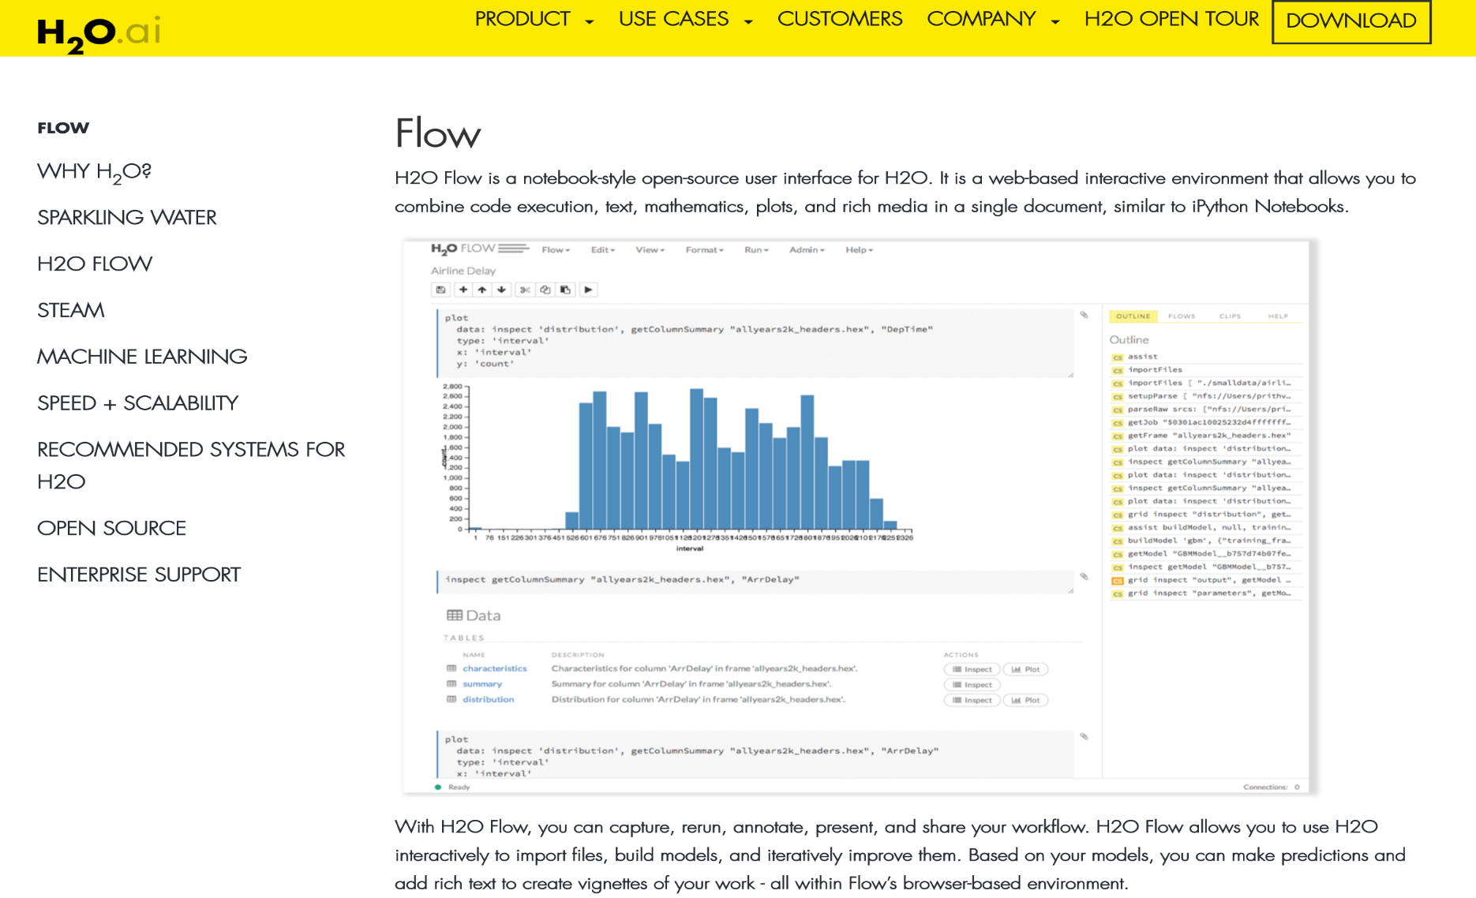
Model

Slide 34
Model

Slide 35

Model

Slide 36
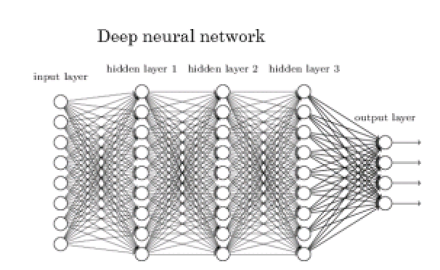
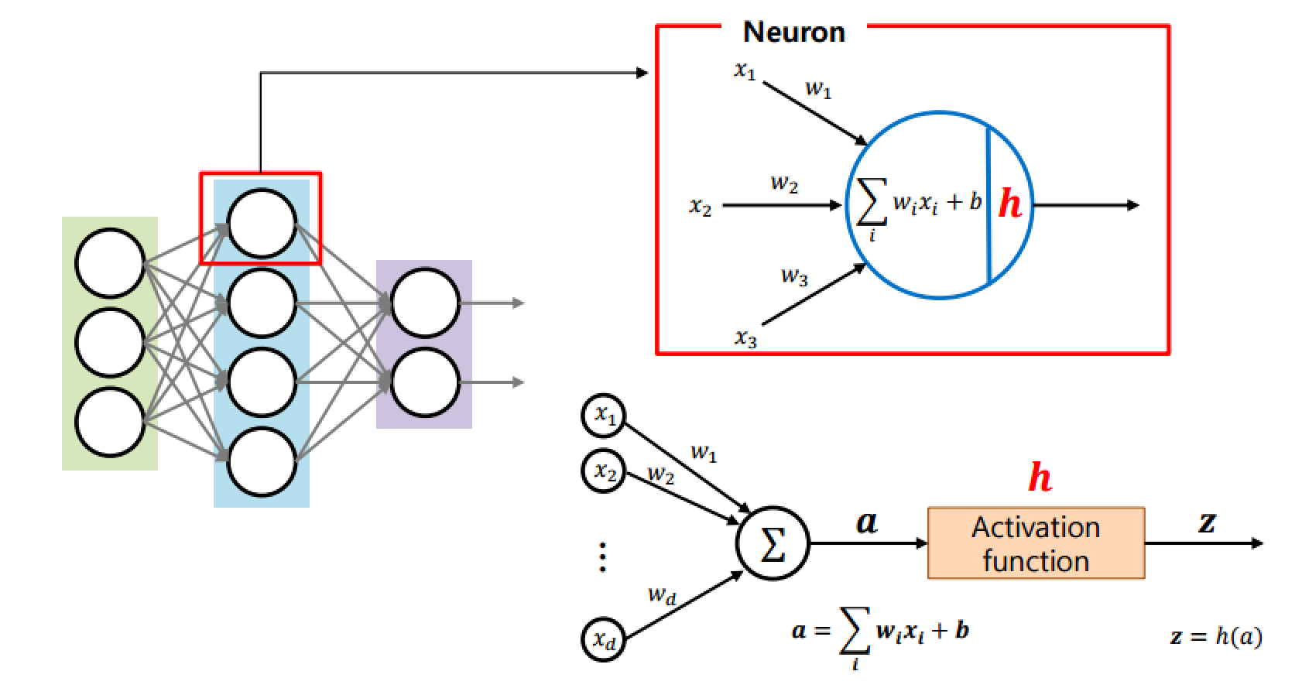
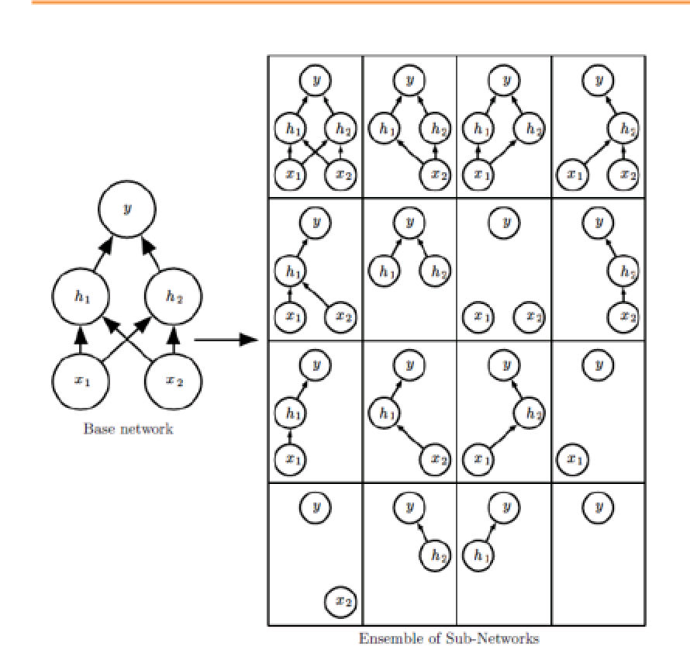
Model
Dropout,
L1, L2 Norm,
Autoencoder,
... 문서 참고바람

Slide 37
Model
pred2 <-as.data.table(predictions[1:100000,-1])
pred2 <-rbindlist(list(pred2, as.data.table(predictions[200001:300000,-1])),use.names=T, fill=T)
(중간생략)
colnames(pred2) <- c('0’,'1','10','11','12','13','14','15','16','17','18','19’, '2','20','21','22','23','24','25','26','27','28','29', '3','30','31','32','33','34','35','36','37','38','39', '4','40','41','42','43','44','45','46','47','48','49’,'5','50','51','52','53','54','55','56','57','58','59', '6','60','61','62','63','64','65','66','67','68','69’,'7','70','71','72','73','74','75','76','77','78','79', '8','80','81','82','83','84','85','86','87','88','89’,'9','90','91','92','93','94','95','96','97','98','99’)
rank_df = as.data.table(t(apply(-pred2[1:100000], MARGIN = 1, rank, ties.method = "first")))
rank_df = rbindlist(list(rank_df,as.data.table(t(apply(-pred2[100001:200000], MARGIN = 1, rank, ties.method = "first")))),use.names=T, fill=T)
(중간생략)
rank_df_names = colnames(rank_df)
extract_colname = function(x, rank = ncol(x)){ rank_df_names[which(x == rank)]}
testpred <- apply(rank_df, 1, function (x) paste(extract_colname(x,1),extract_colname(x,2),extract_colname(x,3),extract_colname(x,4),extract_colname(x,5),collapse=" "))
sb <- read.csv("sample_submission.csv", header=T, stringsAsFactors=F)
sb$hotel_cluster <- testpred
write.csv(sb, "testall_submission.csv", row.names = F)

Slide 38
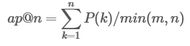
Evaluation
Concept
MAP (Mean Average Precision)
Precision = (true positive) / (true positive + false positive)
AP@n (Average Precision @ n)
m: positive 아이템의 개수
n: 추천할 아이템의 개수
P(k): k번째까지의 정확도. k번째의 값이 false positive일 경우 P(k)=0

Slide 39
Evaluation
Example
MAP@5 : hotel 클러스터를 5개까지 예측. 빠른 순서에 정확하게 예측할수록 Average Precision 상승
예측 | Averge Precision
O X X X X | 1
X O X X X | 1 / 2 = 0.5
X X O X X | 1 / 3 = 0.33333333…….
X X X O X | 1 / 4 = 0.25
X X X X O | 1 / 5 = 0.2
X X X X X | 0

Slide 40
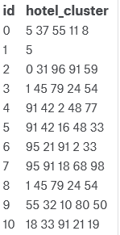
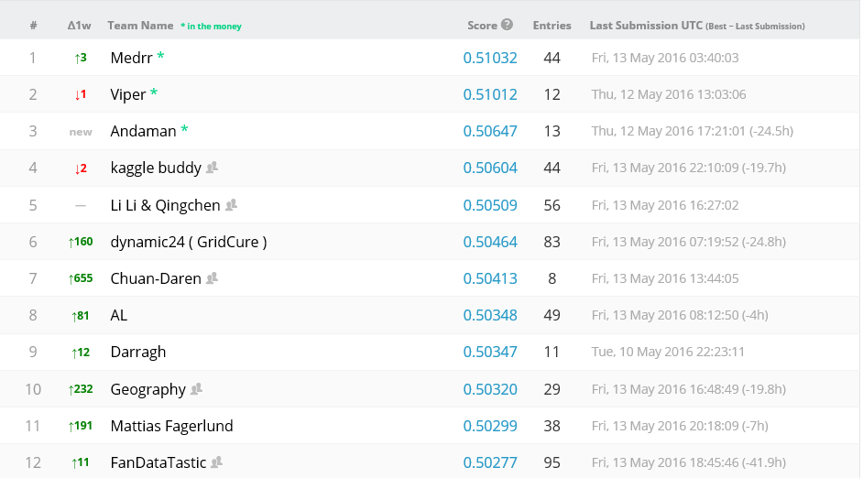
Evaluation
Example
파일 제출 양식

Slide 41
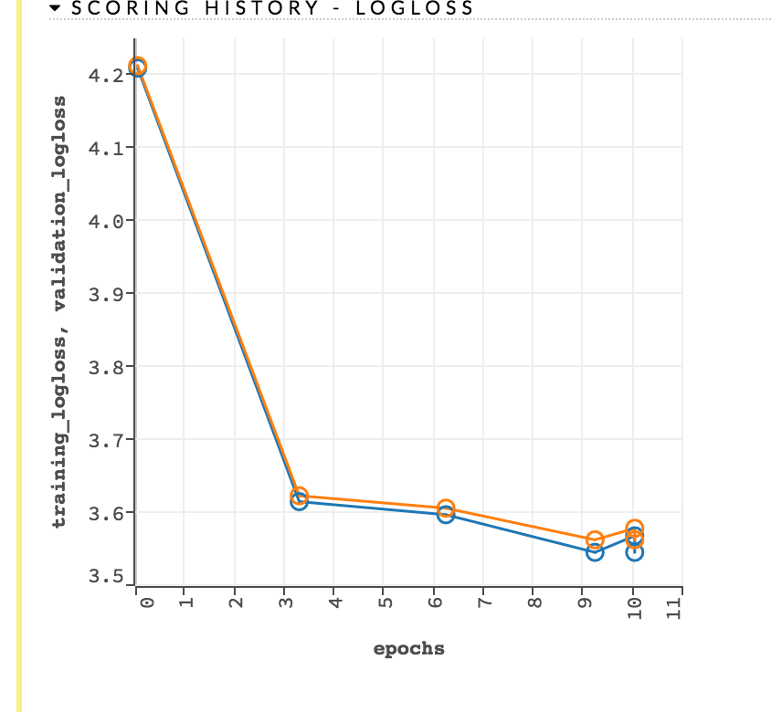
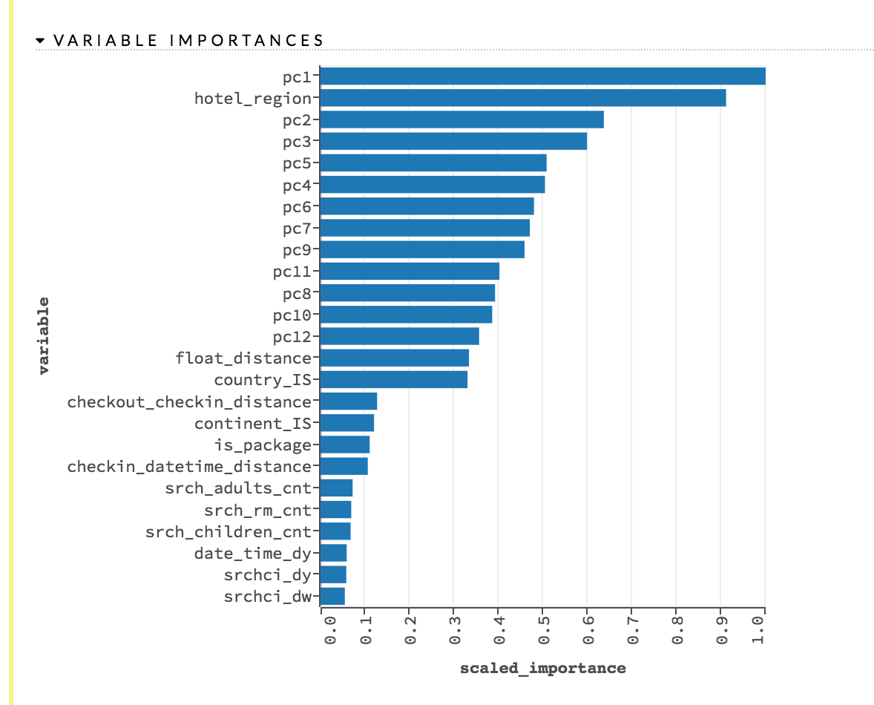
Evaluation
평가함수(LogLoss)
변수중요도(h2o)

Slide 42
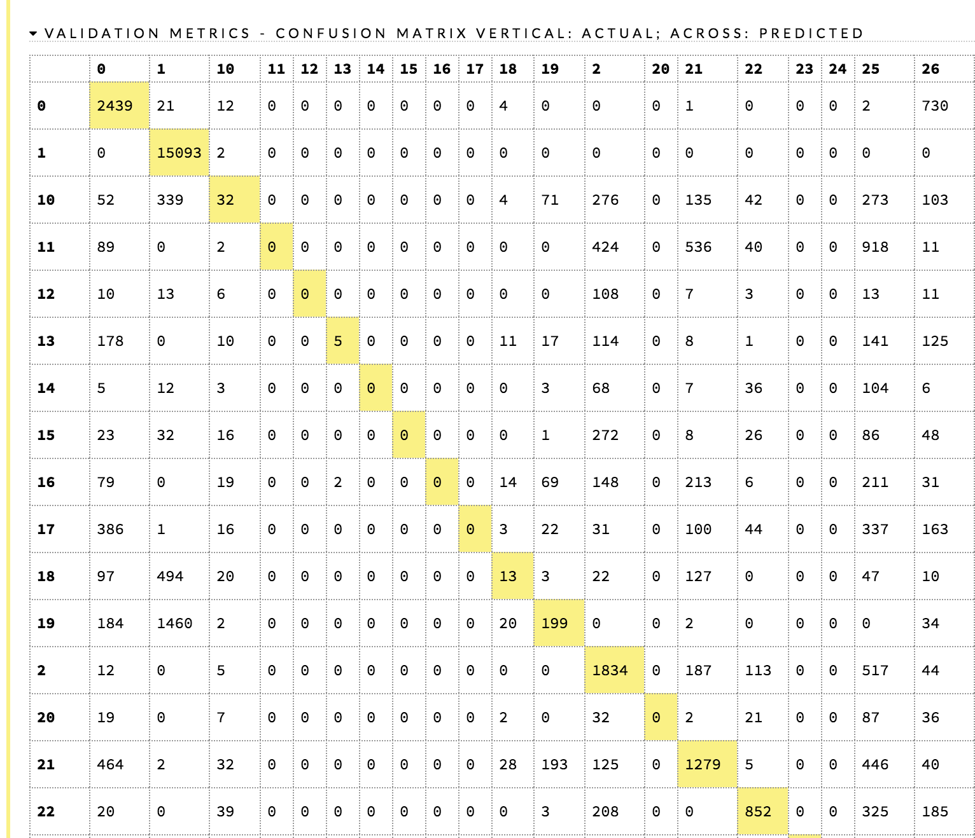
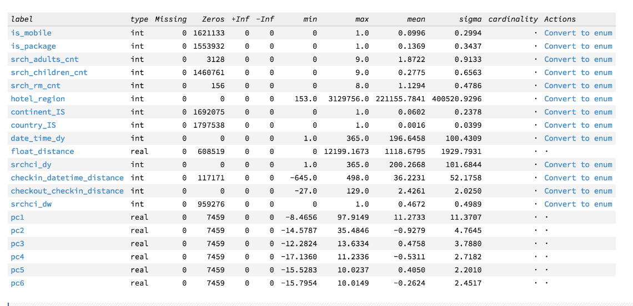
Evaluation
Confusion Matrix
변수 통계량

Slide 43
Evaluation
Confusion Matrix
변수 통계량

Slide 44
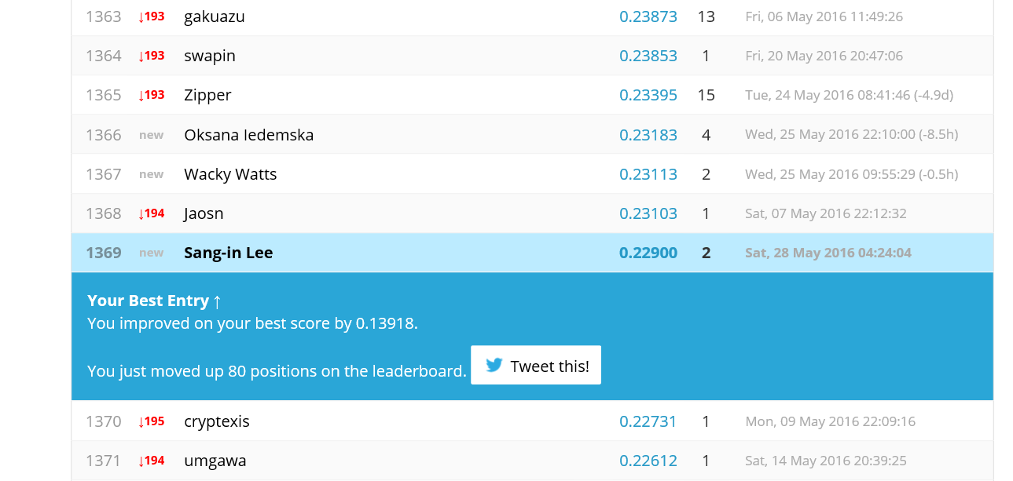
Evaluation
anscombe's quartet
예측력이 생각보다 낮은 이유
데스크탑에서 돌려 속도 문제로 변수를 모두 integer 한 변수만 삽입. (변수 모두 사용하지 못함)
예약 데이터만 사용 (클릭 데이터 미사용, 클릭 데이터가 상당히 많음)
https://www.kaggle.com/dvasyukova/expedia-hotel-recommendations/the-locations-puzzle/comments
Desitination pca 변수중 70%만 사용. (현재 중요변수가 대부분 이곳에서 발생)
마찬가지 속도 문제로 딥러닝 파라미터를 낮게 조절함.
1,3,4번만 해결해도 0.3~0.4 수준으로 오를거로 기대. 2번이 해결되어야 0.5정도로 오를거로 기대됨.

